Slide 1
EUCLIMIT model consortium: providing analytical input to EU climate policy processes
Lena Höglund-Isaksson
Senior research scholar
Pollution Management Group, Energy, Climate, and Environment Program
International Institute for Applied Systems Analysis (IIASA), Austria
Email: hoglund@iiasa.ac.at

Slide 2
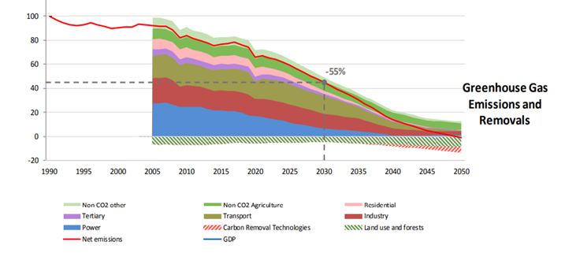
EU Green Deal (2020) and Fit for 55 legal proposal (2021)
1990=100

Slide 3
EUCLIMIT consortium model setup: used by EC as analytical basis for developing legal climate proposals (ETS & ESR)
Macroeconomic projections: JRC and E³modelling (PRIMES model)
Energy & Transport sector projections incl. CO₂ emissions: PRIMES model
Agricultural sector projections: CAPRI model (EuroCare, Bonn)
Waste & F-gas use projections:
GAINS (IIASA)
IIASA’s GAINS model contributes non-CO₂ scenarios and mitigation cost curves, air pollution impacts
IIASA’s GLOBIOM model contributes CO₂ scenarios from Land-use, land-use change and forestry
Why model exercise?
Consistency in assumptions across countries
Independent assessment
Trust in fairness of process

Slide 4
Full consortium project run from Draft to Final (2-3 years cycles) under EC service contracts (since 2010)
EC prepares impact assessment and legal proposals for ETS and ESR national targets, also adding equity aspects to technical assessment
1. Updates of input data from latest statistics +model improvements
2. Draft Reference scenario, Technical mitigation potentials and cost curves
3. EC leading Member state and industry stakeholder consultations on Drafts
4. Implementation of feedback from consultations
5. Final Reference and mitigation scenarios and cost curves
Important features:
Transparency
Timing
Trust
Teamwork across disciplines & models

Slide 6
Greenhouse gas–Air pollution Interactions and Synergies: The GAINS tool
Social development and economic activities
Emission control options: ~2000 measures, co-control of 10 air pollutants and 6 GHGs
Emissions
Costs
Optimization
Atmospheric dispersion
Health, ecosystems and climate impact indicators
Policy targets

Slide 7
Non-CO₂ sources covered in GAINS

Slide 8
Current legislation considered in GAINS non-CO₂ Draft Reference scenario

Slide 9
EU27: Baseline non-CO₂ emissions

Slide 10
EU27: Additional non-CO₂ mitigation potential
Reduction from 2015:
Baseline: Max:
2030:
non-agriculture: -46% -69%
agriculture: -6% -26%
total: -26% -47%
2050:
non-agriculture: -66% -87%
agriculture: -10% -36%
total: -37% -61%

