Slide 1
The natural scientific basis for climate adaptation in Norway
-Knowledge for a climate robust society
Anita Verpe Dyrrdal
Notes:
Norwegian Centre for climate services is a collaboration between
Norwegian Meteorological institute
Norwegian Water Resources and Energy Directorate
NORCE research and Bjerknes centre.
The Norwegian Environment Agency is on our board.

Slide 2
NCCS is
a collaboration between
MET Norway (member of CIENS)
Norwegian Water Resources and Energy directorate (NVE)
NORCE Norwegian Research Centre
Bjerknes Centre for Climate Research

Slide 3
Who are our users?
Norwegian Environment Agency
Authorities on national, regional and local level
Municipalities, consultants
Sectoral decision makers
Infrastructure owners
Impact research
General public

Slide 4
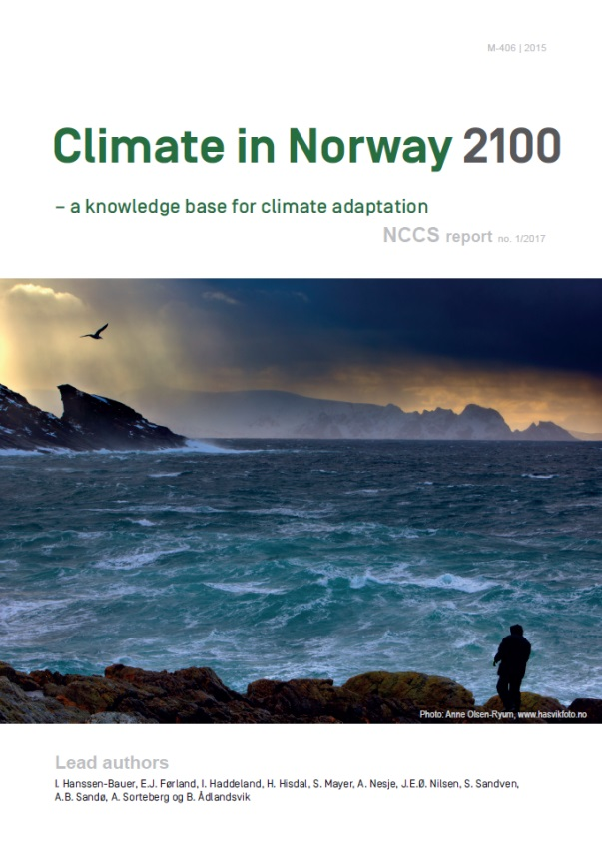
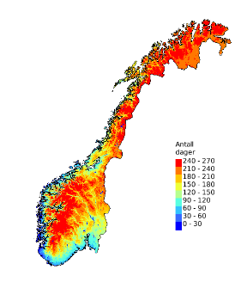
Climate projections for Norway
1. Emission scenario | 2. Global climate models | 3. Regional climate models | 4. Bias adj. hyd.mod. 1 x 1 km | 5. Users
Fig: Oskar Landgren,
Modified by Anita Dyrrdal
Notes:
Both dynamical and statistical downscaling. We will use a wide range of emission scenarioes. Today the Norwegian government recommends using the “preparedness principle” when working with climate adaptation in Norway, which in practice has meant the highest scenario. But it is also important to show how the world can look like under the Paris agreement.
We will select a representative ensemble of RCM-results from EURO-CORDEX for further downscaling to a 1x1 km grid over the Norwegian
mainland (precipitation, temperature, wind) and these will be further input to hydrological models.
These downscaled climate projections for key variables are used to compute expected changes in different sector-specific indices,
and will be the basis for an update of the report Climate in Norway 2100 and the regional climate fact sheets.

Slide 5
Climate in Norway 2100
Historical and future development in climate and hydrology, and the effect on natural hazards
Launch of 3rd version in 2024/25

Slide 6
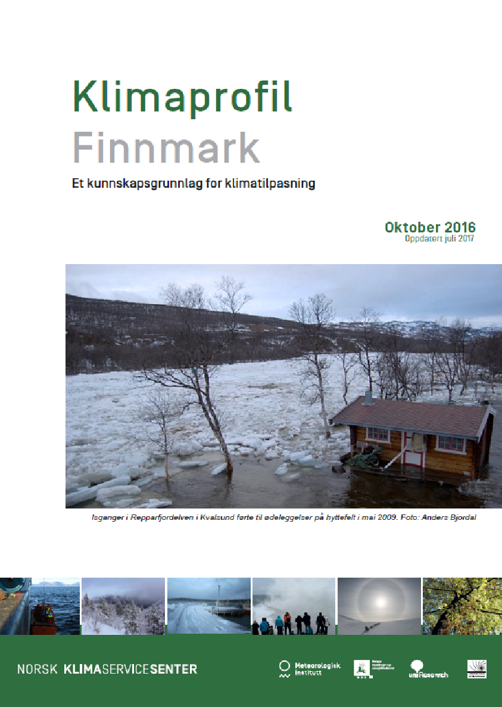
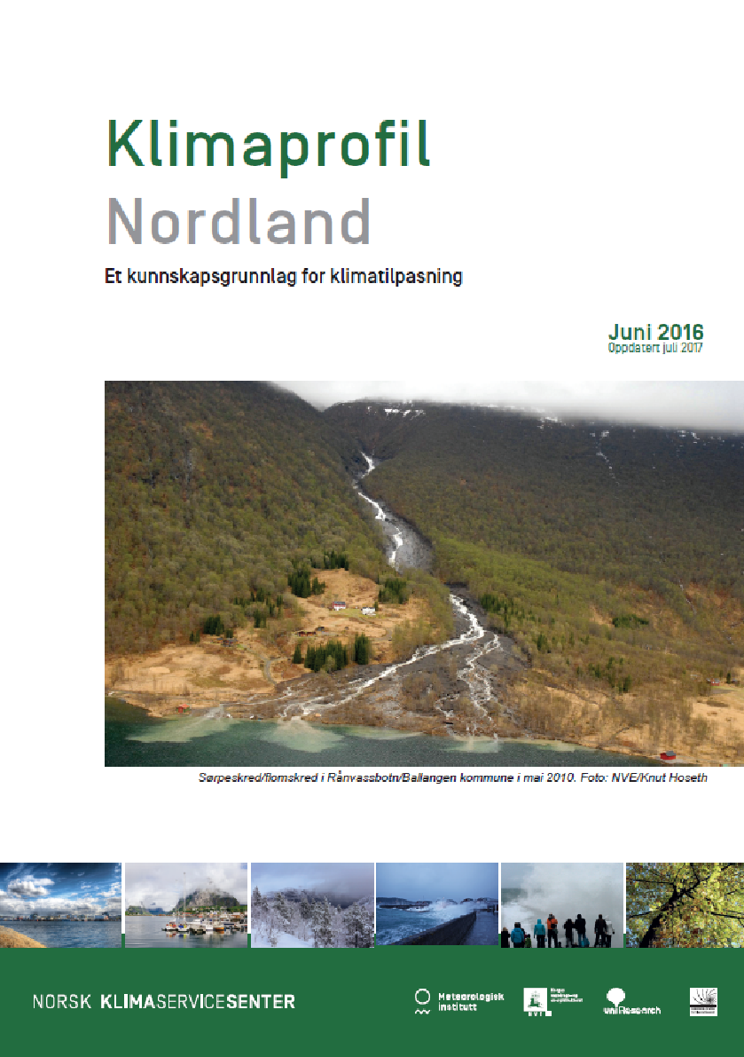
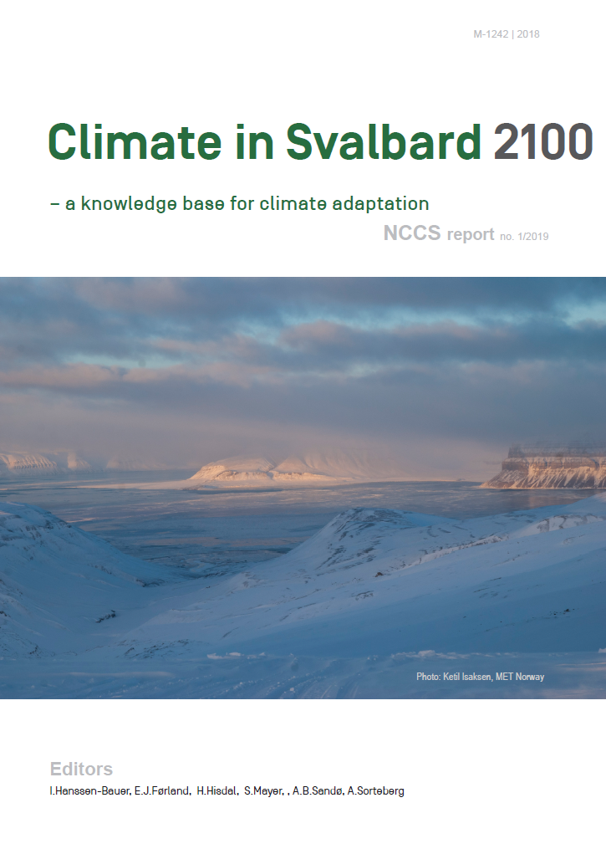
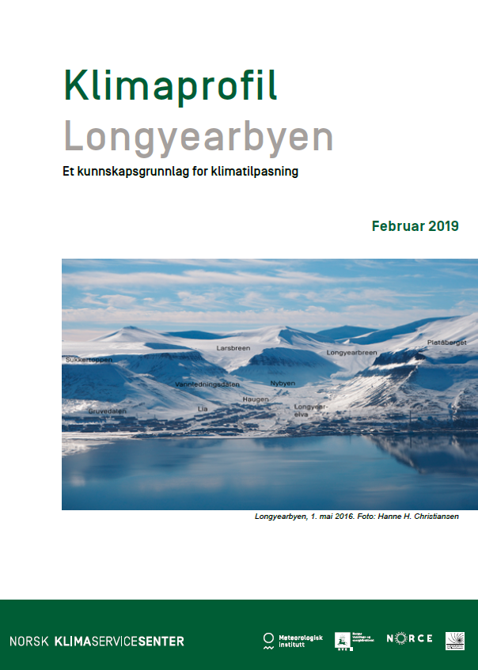
Co-produced climate fact sheets
Notes:
Co-production: created for and by the municipalities
The most important future developments in each county

Slide 7
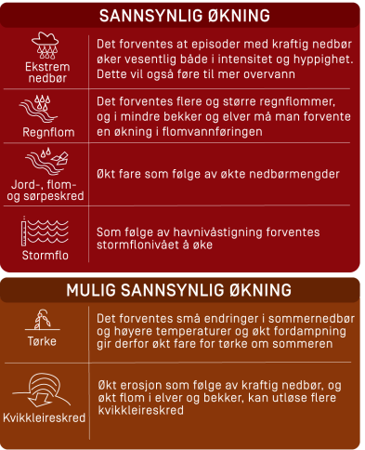
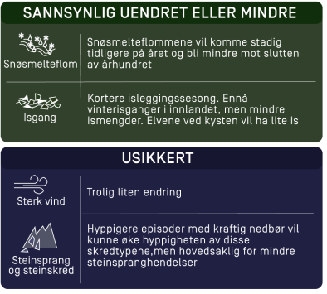
Climate fact sheet Oslo & Akershus
Extreme precipitation
Rain flood
Slides & avalanches
Snowmelt flood
Storm surge
Ice drift
Drought
Strong wind
Rock slides
Quick clay

Slide 8
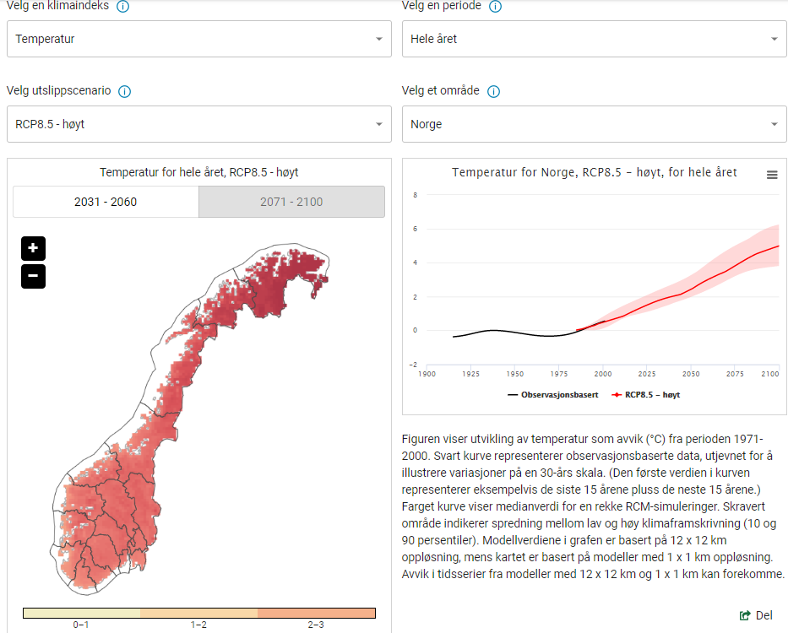
Website with climate projections
Data as netcdf
1x1 km
Median of 10 simul.
Standard variables
User specific indices
Medium and high emission scenario
Available for download

Slide 9
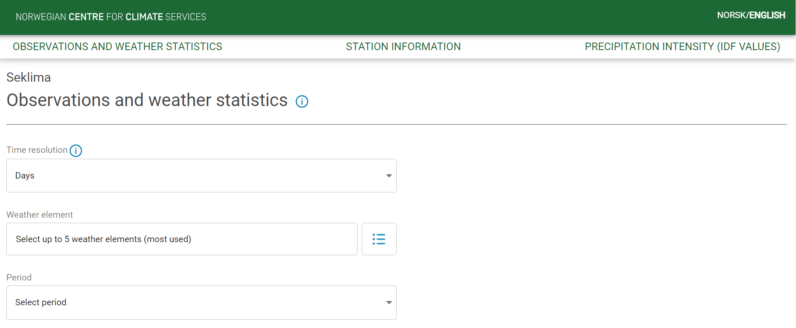
Historical climate: all observations are open and free

Slide 10
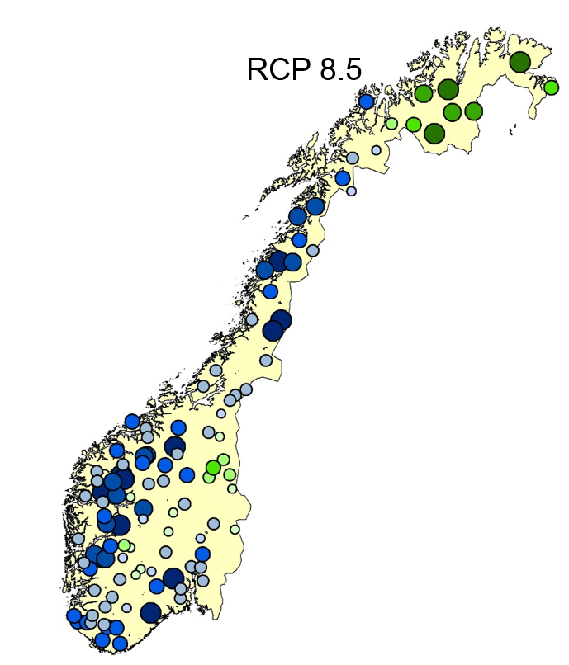
Climate change allowance for flooding
Snow melt dominated 0 %
Rain flood dominated
+ small catchments 20%
Some areas can expect larger changes 40%
200-year flood
Smaller
Larger

Slide 11
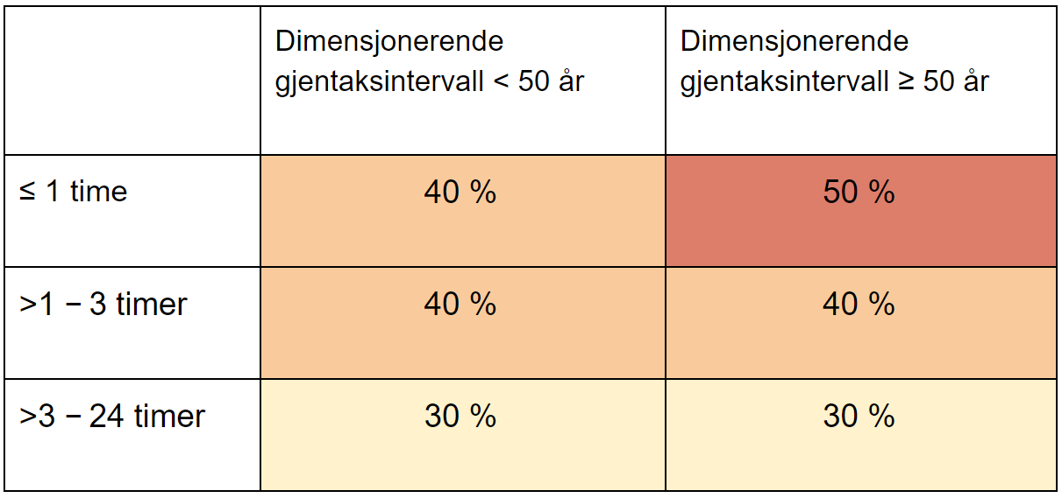
Climate change allowance
Heavy rainfall
Less critical infrastructure
More critical infrastructure

Slide 12
NEW climate projections for Norway
Empirical statistical downscaling
1. Emission scenario Low Medium High (SSP3-7.0) | 2. Global climate models CMIP5 CMIP6 | 3. Regional climate models EURO-CORDEX NorCP | 4. Bias adj. hyd.mod. 1 x 1 km | 5. Users
Fig: Oskar Landgren,
Modified by Anita Dyrrdal
Notes:
Both dynamical and statistical downscaling. We will use a wide range of emission scenarioes. Today the Norwegian government recommends using the “preparedness principle” when working with climate adaptation in Norway, which in practice has meant the highest scenario. But it is also important to show how the world can look like under the Paris agreement.
We will select a representative ensemble of RCM-results from EURO-CORDEX for further downscaling to a 1x1 km grid over the Norwegian
mainland (precipitation, temperature, wind) and these will be further input to hydrological models.
These downscaled climate projections for key variables are used to compute expected changes in different sector-specific indices,
and will be the basis for an update of the report Climate in Norway 2100 and the regional climate fact sheets.

