Slide 1
Climate services AU/iCSC

Slide 2
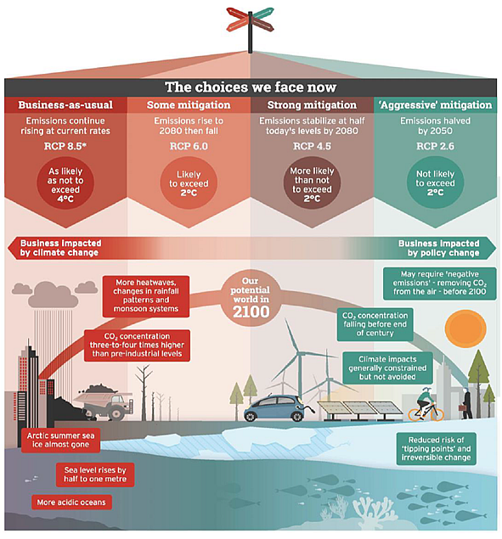
Challenges we face
Physical risks
Transitional risks

Slide 3
Paris and Rcp 2.6
We face major transitional and physical risks
Assess transitional risks → GHG emissions and just value-chain management is needed – in other words adaptation to mitigation
Climate services must be able to address both types of risks and support accelerated climate friendly transition and innovation

Slide 4
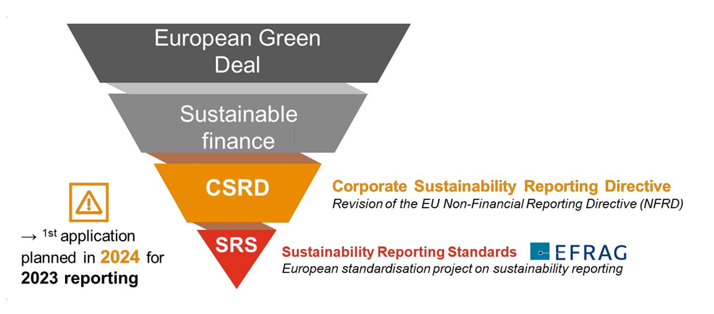
CS activities at Aarhus University
Working directly with end-users and market needs – currently primarily on transitional risks and adaptation to a Paris Agreement economy (adaptation to mitigation)
CS has traditionally been about adding value to physical climate data to support adaptation decision making – this is still important.
At AU we are however also adding assessment and management of transitional risks to the CS portfolio to ensure a one-stop-shop for climate risk needs
Support companies in delivering the required CSRD reporting (see below) and climate risk management strategies and thus the sustainable finance and green deal objectives

Slide 5
Research projects interacting with stakeholders
Aarhus floor map
High resolution large scale floor maps
– e.g. 3x5m
Walkable (no shoes)
Dynamic elements: QR codes
Can contain any information relevant for a specific site
Fixed elements
Flood areas of e.g. 100 yr event
twitter.com/REGREEN-nbs
linkedin.com/company/regreen-horizon-2020
CONTACT:
Email: regreen.nbs@gmail.com
Website: www.regreen-project.eu
© Wanben Wu

Slide 6
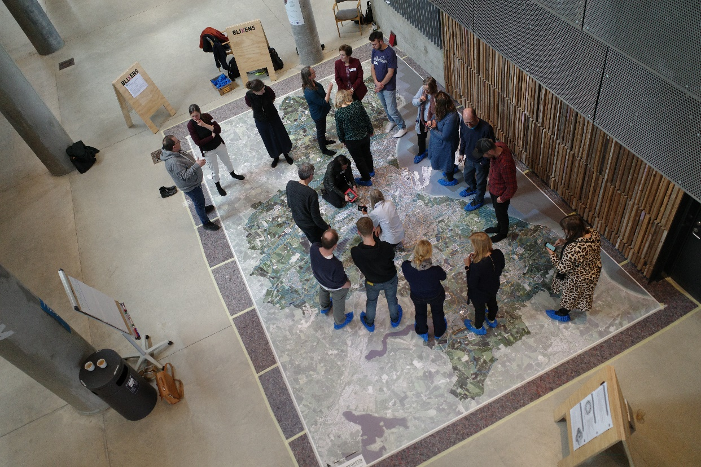
Potential of floor maps
Supports the spatial understanding of scientists and stakeholders
Induces new types of discussions and learnings
Sensibilises perception of areas and context understanding
Improves planning processes and outputs
© Signe Iversen
Stakeholders and
scientists in discussion

Slide 7
questions
Questions for IIASA and PEER partners to prepare for the meeting:
What type of services does your organization develop and for which sectors?
Public (municipalities and private companies)
What is the role of private sector, research institutes, and different stakeholders in the development of the services?
We are working closely with both private companies and public bodies and reach out to companies and public organizations who need help
What topics do PEER partners believe are of key importance towards the development and implementation of the services?
To understand the EU Green Deal developments and the needs of the clients including the regulatory requirements the are facing.
What is the role of citizen science and local knowledge and its integration with the scientific knowledge to increase the efficiency of/improve the services?
Not sure
How do you define/measure efficiency of the provided services?
Number of companies addressing their climate budgets and reducing their emissions.
How can the PEER institutes collaborate in the development of services?
In many ways of course – sharing practices and tools and knowledge
How can the EU invest in the efficient development of services?
Build on the CS Road Map.

