Slide 1
IIASA
Dr. Albert van Jaarsveld
IIASA Director General and Chief Executive Officer
PEER Workshop
May 2022

Slide 2
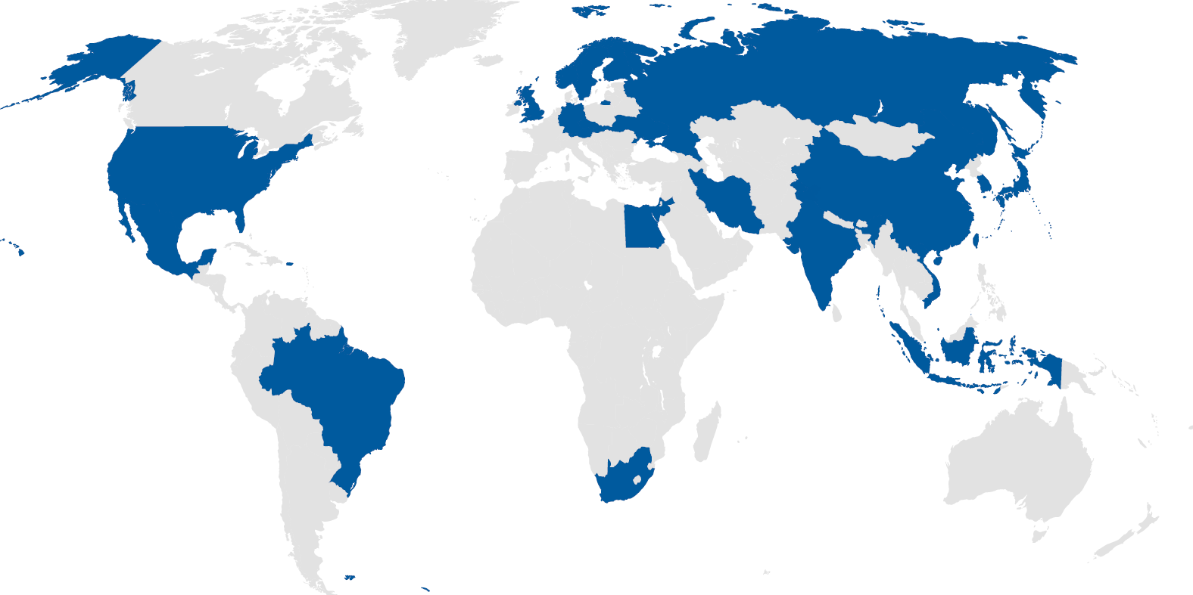
IIASA is… An international research institute that conducts multidisciplinary/ transdisciplinary research to help policymakers find long-term solutions to global and universal challenges facing humanity

Slide 3
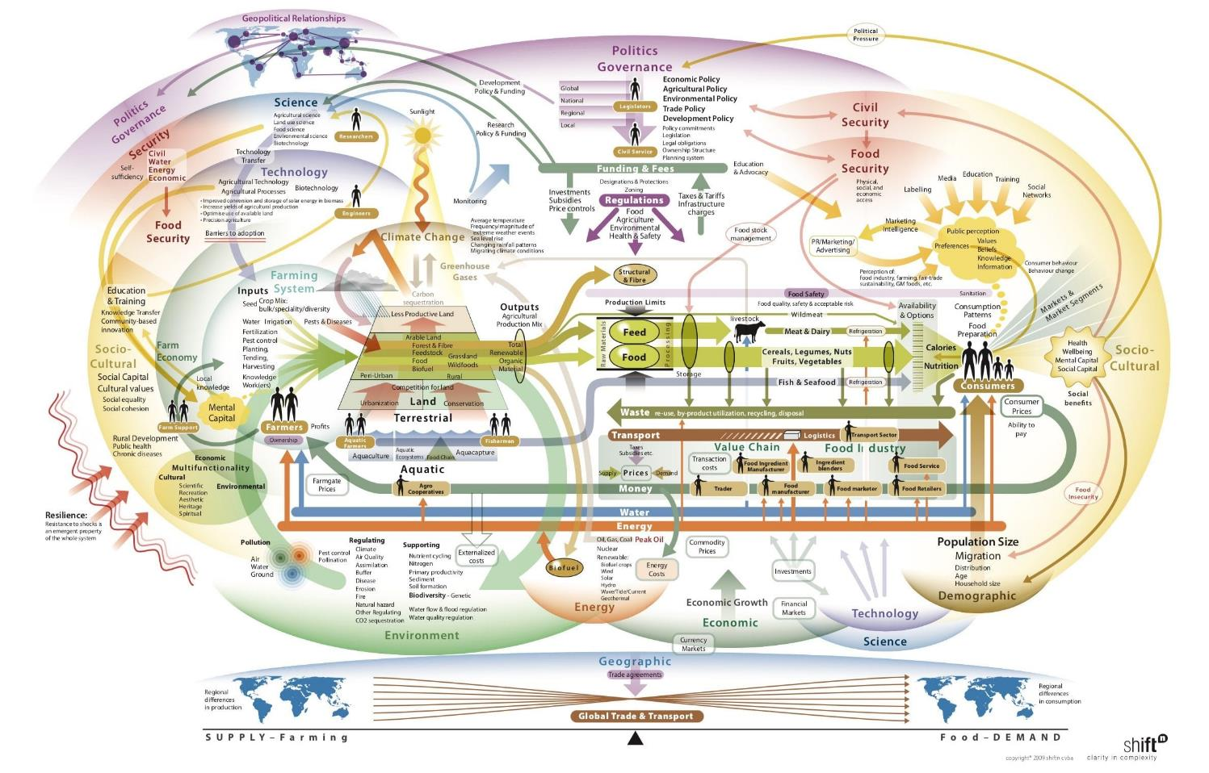
The world is complex as are the key
political and scientific challenges of the day

Slide 4
IIASA Integrated Assessment Framework
National level Projections
Population
Economy
Climate
(MAGICC)
Water supply, demand & quality
(Community Water Model-CWatM)
Citizen Science
(GEO-WIKI.ORG)
Forest Management
(G4M)
Greenhouse gases and air pollution mitigation
(GAINS)
Energy Planning (MESSAGE)
Agriculture, bioenergy and forestry (GLOBIOM)
Agricultural crops
(EPIC)
Aggregated macroeconomic (MACRO)
Fuel choice model
for cooking
(Access)
Transport
Renewable energy systems
(BeWhere)

Slide 5
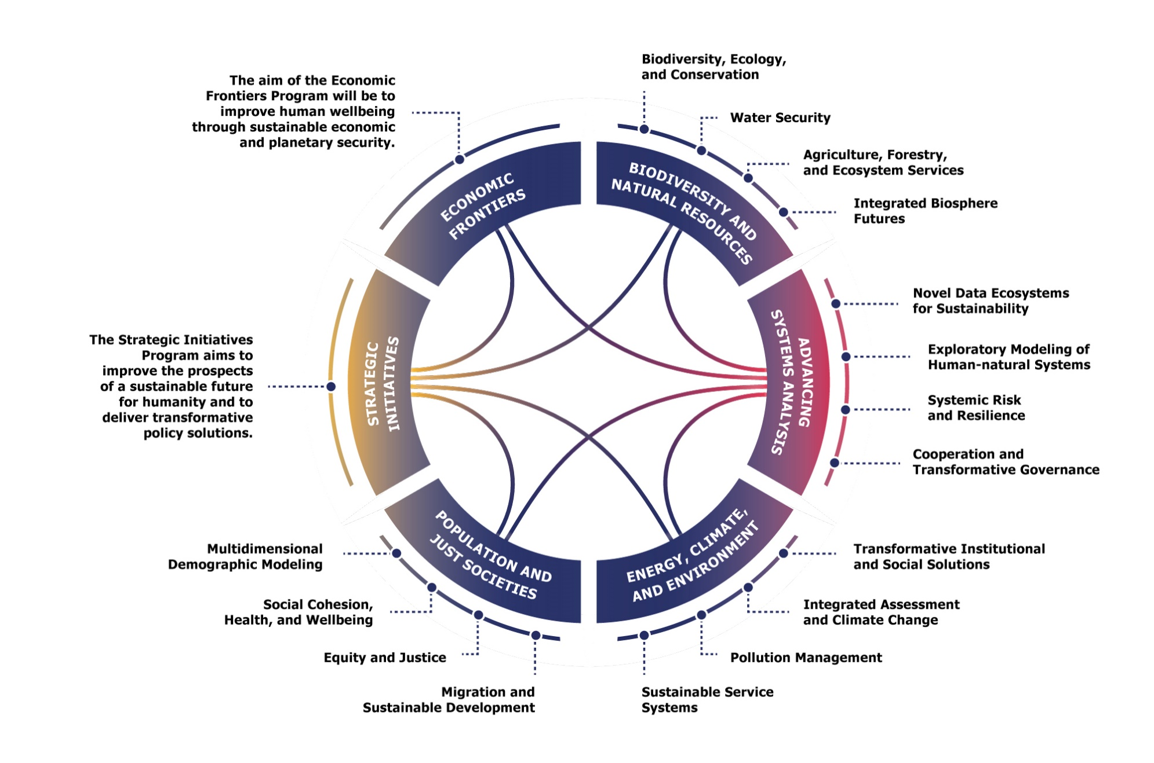
New Research Programs and Groups

Slide 6
Publication Output
 | 2017 | 2018 | 2019 | 2020 | 2021
IIASA Publications in PURE | 610 | 591 | 563 | 667 | 655
Number of peer-reviewed articles in PURE | 368 | 382 | 391 | 443 | 460
Peer-reviewed journal articles according to SCOPUS | 255 | 297 | 314 | 377 | 392
Citations of IIASA publications according to SCOPUS | 20926 | 25866 | 28603 | 33699 | 43425
 | Mar 2021 | Aug 2021 | 2021
H-Index (SCOPUS) | 185 | 193 | 204
Notes:
Source: SCOPUS, an independent database of peer-reviewed literature from the publisher Elsevier
This h-index measures the productivity and impact of the journal articles by IIASA authors in different databases of peer-reviewed literature. An h-index of 100 means that of all IIASA journal articles, 100 articles have been cited more than 100 times.

Slide 7
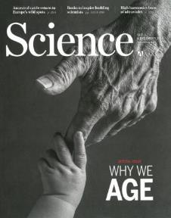
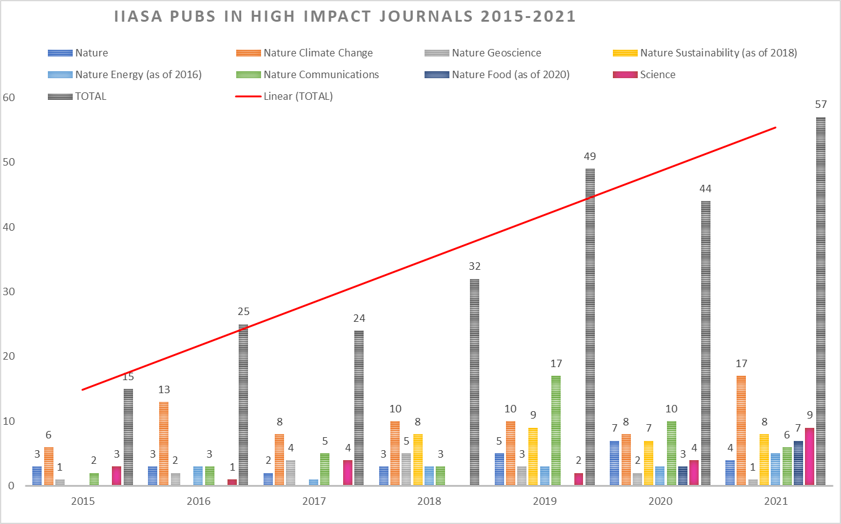
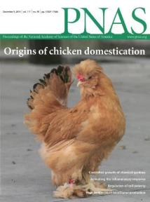
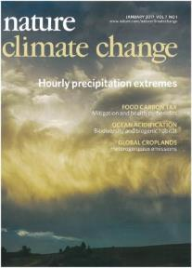
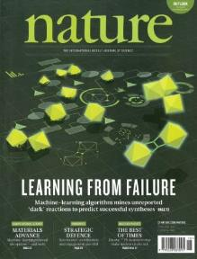
High-impact Publications 2015-21

Slide 8
Policy citations 2018 2021

Slide 9
Thank you
For further information about IIASA:
www.iiasa.ac.at or inf@iiasa.ac.at
Subscribe to IIASA’s publications:
www.iiasa.ac.at/keepintouch

Slide 10
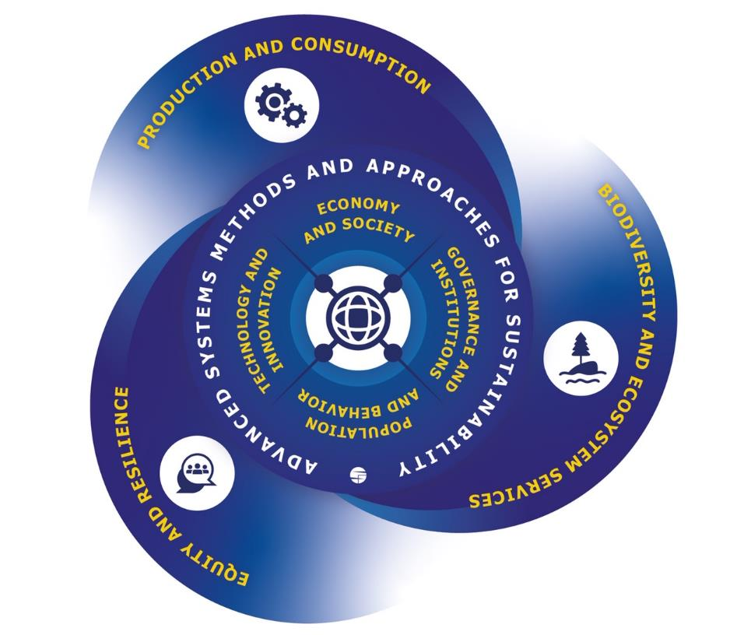
IIASA Research Strategy (2021-2030) The Seven Research Themes
What’s New?
Seven new interlinked research themes and six new programs
Brand new research foci include: Just Societies, New Economic Frontiers. Biodiversity
Large-scale interdisciplinary research projects collectively agreed by NMOs and IIASA
Increased capacity development opportunities in systems analysis for NMOs (including access to models)
Growth in IIASA as a facilitator for science diplomacy
Notes:
Extra Slide

