Slide 1






On the relevance of climate information services
to the development of climate related
EU policies and strategies
IIASA-PEER workshop on Climate Information Services for Society on 19 May 2022
Presented by Claus Kondrup, Senior Expert, European Commission, DG Climate Action
ec.europa.eu/
clima/
facebook.com/
EUClimateAction
twitter.com/
EUClimateAction
pinterest.com/
EUClimateAction
youtube.com/
EUClimateAction

Slide 2
Introduction
Focus on climate services related to adaptation to climate change
IPCC Glossary (https://apps.ipcc.ch/glossary/):
  Climate services refers to information and products that enhance users’ knowledge and understanding about the impacts of climate change and/or climate variability to aid decision-making of individuals and organizations and enable preparedness and early climate change action.
  Such services involve high-quality data from national and international databases on temperature, rainfall, wind, soil moisture and ocean conditions, as well as maps, risk and vulnerability analyses, assessments, and long-term projections and scenarios – which may be combined with other data …

Slide 3
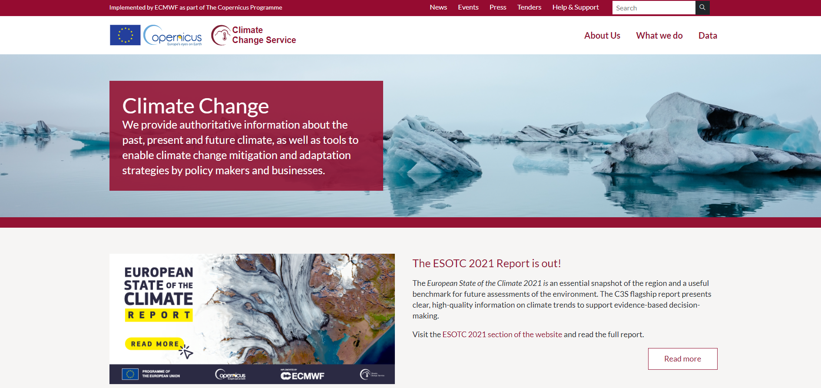
Copernicus Climate Change Service C3S
https://www.copernicus.eu/en/copernicus-services
https://climate.copernicus.eu/

Slide 4
European Climate Law
https://eur-lex.europa.eu/legal-content/EN/TXT/?uri=CELEX:32021R1119
Article 6(4):
  The Commission shall assess the consistency of any draft measure or legislative proposal, including budgetary proposals, with the climate-neutrality objective …
  The Commission shall also assess whether those draft measures or legislative proposals, including budgetary proposals, are consistent with ensuring progress on adaptation as referred to in Article 5.
Article 5:
  The relevant Union institutions and the Member States shall ensure continuous progress in enhancing adaptive capacity, strengthening resilience and reducing vulnerability to climate change in accordance with Article 7 of the Paris Agreement. …

Slide 5
https://ec.europa.eu/info/law/law-making-process/planning-and-proposing-law/better-regulation-why-and-how/better-regulation-guidelines-and-toolbox_en
Better Regulation
Guidelines + Toolbox:
  Consistency vis-à-vis European Climate Law objectives
  Assessing policy risks including in relation to climate change
  Identifying climate risks: scientific models, climate scenarios, …
  Assessing climate risks (four Policy Coherence Principles):
    (i) taking into account risk before creating new exposure,
    (ii) reducing existing risk by building up resilience;
    (iii) managing residual financial risk
    (iv) assigning risk ownership.
  Key question: How does the policy affect our adaptive capacity, resilience, or vulnerability for climate change?

Slide 6
EU Adaptation Strategy
https://eur-lex.europa.eu/legal-content/EN/TXT/?uri=COM:2021:82:FIN
The long-term vision is that in 2050, the EU will be a climate-resilient society, fully adapted to the unavoidable impacts of climate change – in line with the Paris Agreement and the European Climate Law.
The strategy aims to realise the 2050 vision of a climate-resilient Union by making adaptation smarter, more systemic, swifter, and by stepping up international action.
Working with Member States, regions, cities and local administrations, public and private sectors, and individual citizens

Slide 7
https://ec.europa.eu/info/research-and-innovation/funding/funding-opportunities/funding-programmes-and-open-calls/horizon-europe_en
Horizon Europe –
Mission Adaptation
Horizon Europe is the EU’s key funding programme for research and innovation with a budget of €95.5 billion.
Includes e.g. Mission Adaptation (±€1bn). Main goal to support at least 150 European regions and communities towards climate resilience by 2030:
  Planning for climate resilience
  Accelerating transformations to climate resilience
  Demonstrating systemic transformations to climate resilience (75 demonstrators)

Slide 8
Horizon 2020
https://op.europa.eu/s/wb95
Climate services turn scientific knowledge on climate variability and change into actionable information that can be exploited by a wide range of users
The information allows the users to account for the effects of climate change into their decision making
This CORDIS Results Pack focuses on 10 EU-funded projects that have developed vital tools and expertise to help mitigate the impacts of a changing climate through the application of climate services.

Slide 9
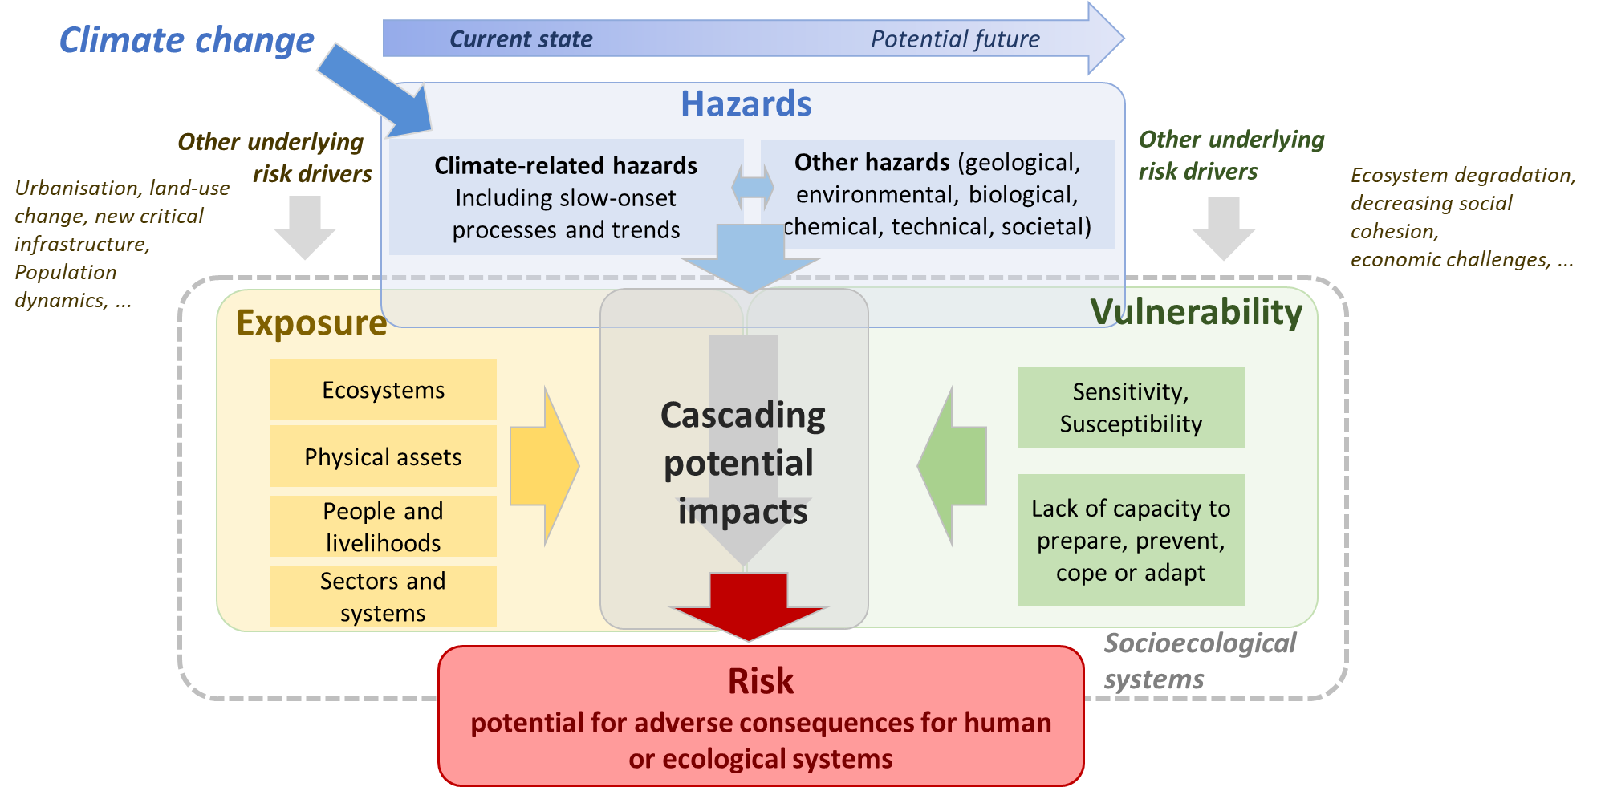
EU-wide Climate Risk Assessment
Proposed framework applies IPCC AR6 risk concept

Slide 10
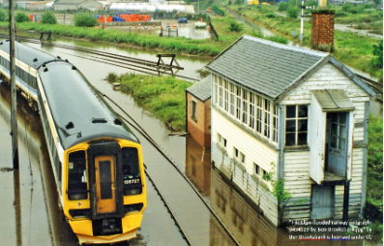
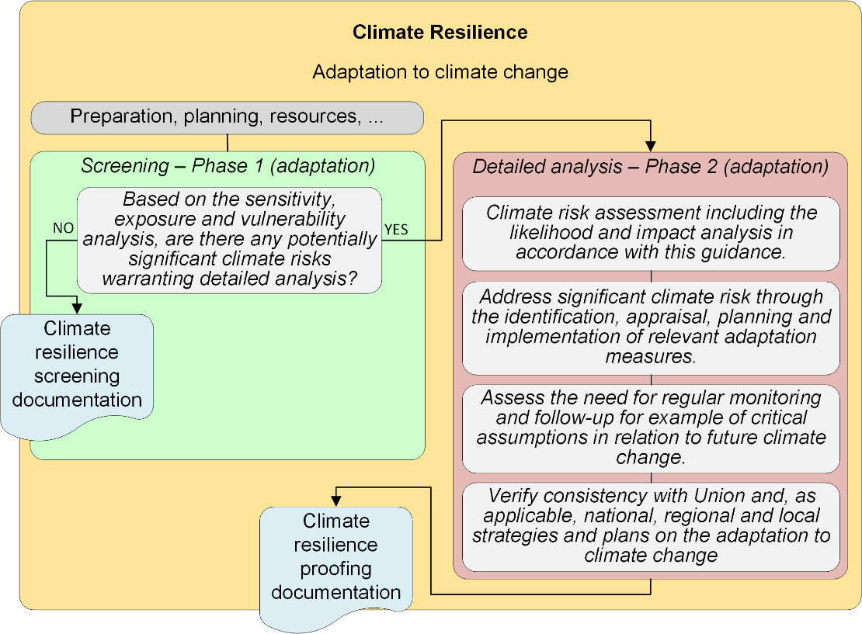
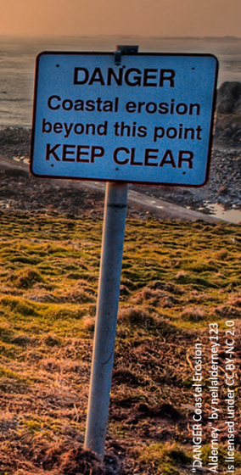
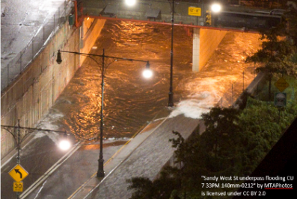
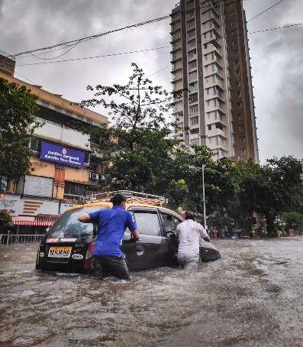
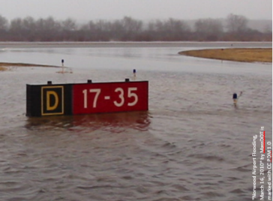
https://eur-lex.europa.eu/legal-content/EN/TXT/?uri=OJ:C:2021:373:TOC
Climate Proofing

Slide 11
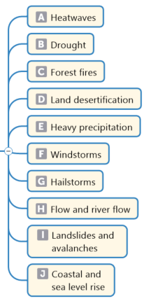
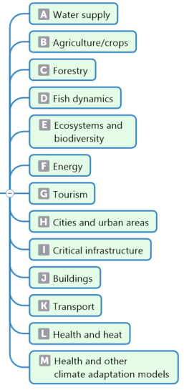
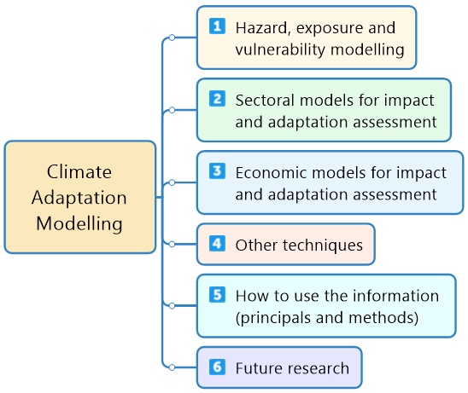
https://www.cmcc.it/sam-ps-study-on-adaptation-modelling-project-outputs#project
Climate Adaptation Modelling

Slide 12
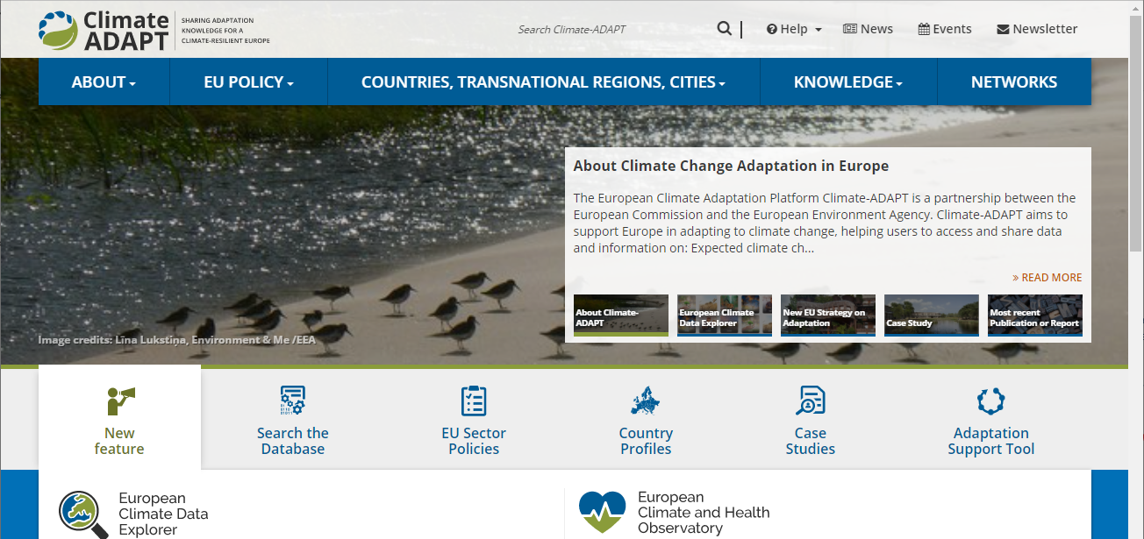
Climate-ADAPT
https://climate-adapt.eea.europa.eu/

Slide 13
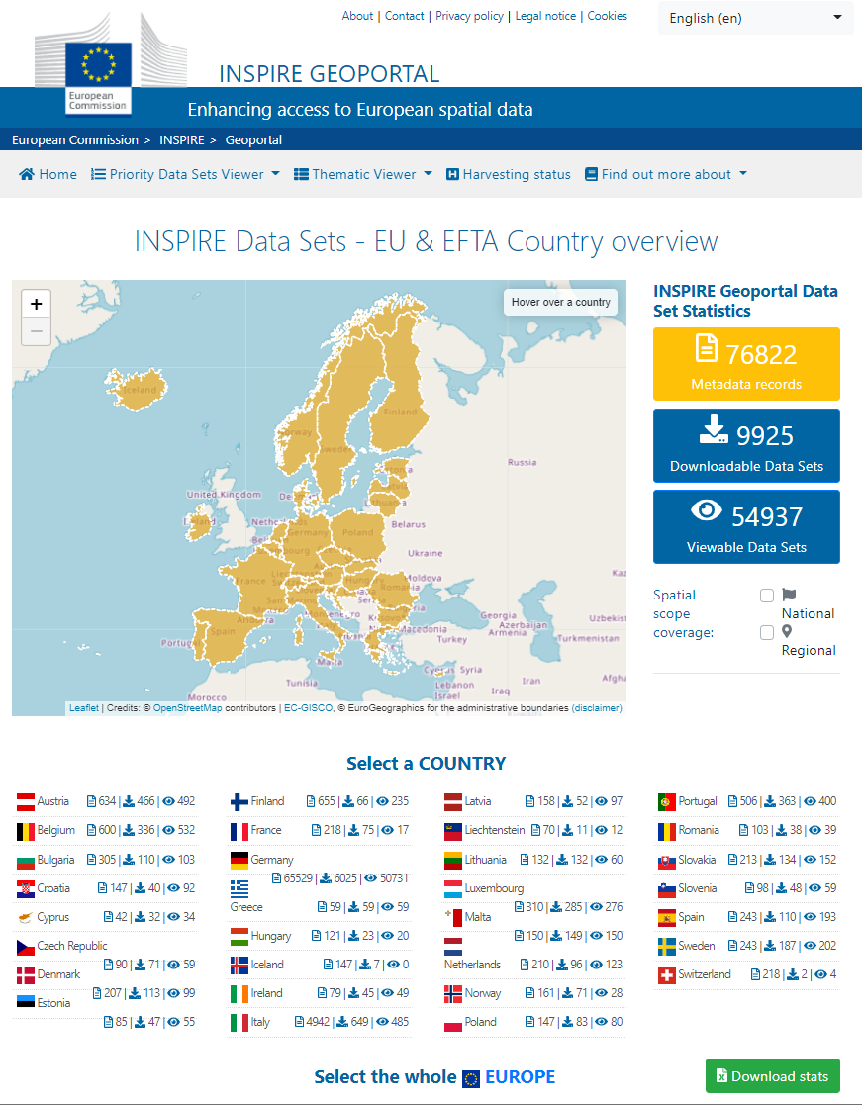
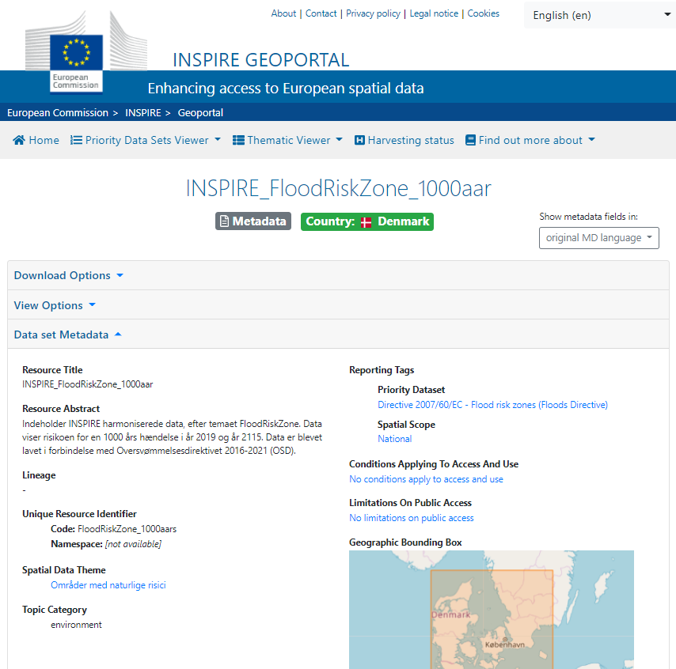
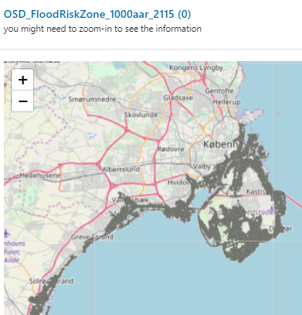
https://inspire.ec.europa.eu/
https://inspire-geoportal.ec.europa.eu/
INSPIRE

Slide 14
Various platforms and data sources
European Commission Disaster Risk Management Knowledge Centre (DRMKC, https://drmkc.jrc.ec.europa.eu/), Risk Data Hub, Inform Climate Change, EIOS
Copernicus Emergency Management Service (https://emergency.copernicus.eu/)
  European Drought Observatory (EDO, https://edo.jrc.ec.europa.eu/)
  European Flood Awareness System (EFAS, https://www.efas.eu/en)
  European Forest Fire Information System (EFFIS, https://effis.jrc.ec.europa.eu/)
  Copernicus EMS On Demand Mapping
Conflict and Geospatial Analysis for Peace and Stability (Science4Peace, https://science4peace.jrc.ec.europa.eu/ )
Global Disaster Alert and Coordination System (GDACS, https://gdacs.org/)
Global Human Settlement Layer (GHSL, https://ghsl.jrc.ec.europa.eu/)
EuroHEAT online heatwave forecast (https://climate-adapt.eea.europa.eu/metadata/tools/euroheat-online-heatwave-forecast)

Slide 15
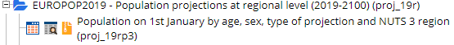
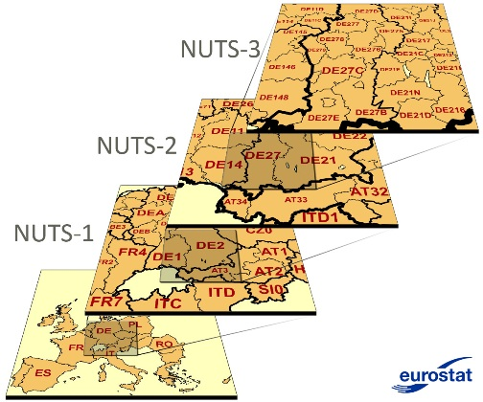
Eurostat – Your key to European statistics
https://ec.europa.eu/eurostat/
The current NUTS 2021 classification is valid from 1 January 2021 and lists 92 regions at NUTS 1, 242 regions at NUTS 2 and 1166 regions at NUTS 3 level.
Purpose: The collection, development and harmonisation of European regional statistics

Slide 16
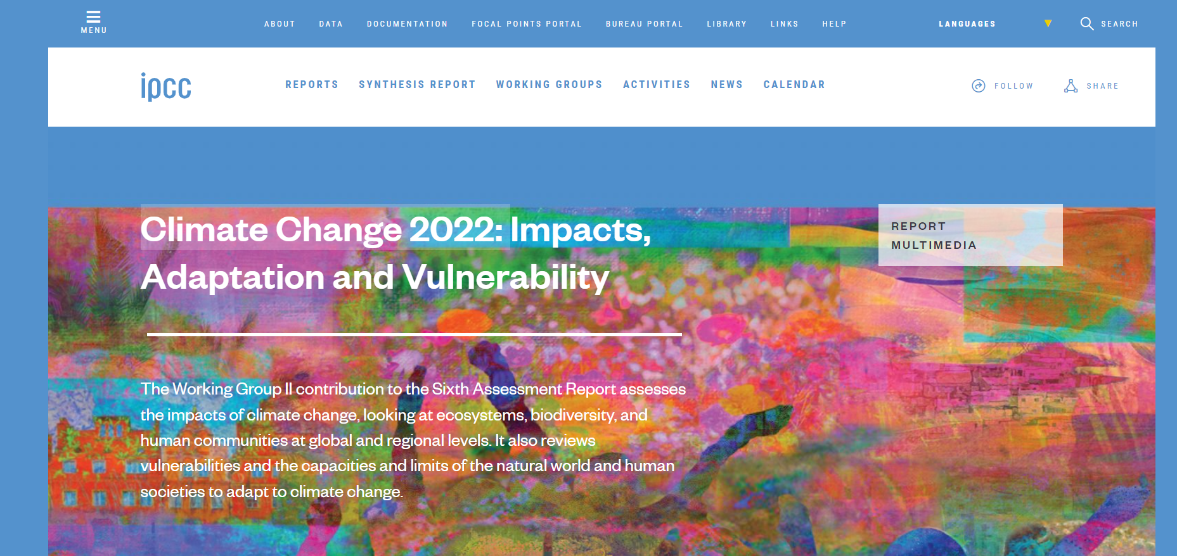
https://www.ipcc.ch/assessment-report/ar6/
https://www.ipcc.ch/report/sixth-assessment-report-working-group-ii/
IPCC Sixth Assessment Report

Slide 17
Concluding remarks
Speed and direction of climate change
Decision-making
Adaptation modelling
Climate services

Slide 18
Thank you for your attention
ec.europa.eu/
clima/
facebook.com/
EUClimateAction
twitter.com/
EUClimateAction
pinterest.com/
EUClimateAction
youtube.com/
EUClimateAction

Slide 19
Climate Adaptation Modelling
Adaptation Modelling – Main Reports – Published on 24 February 2021:
Workshop proceedings on climate adaptation modelling: https://link.springer.com/book/9783030862107
Climate Adaptation Models and Tools – Main Report – Comprehensive desk review: https://op.europa.eu/en/publication-detail/-/publication/9383d16e-7651-11eb-9ac9-01aa75ed71a1
Climate Adaptation Models and Tools – Annexes – Comprehensive desk review: https://op.europa.eu/en/publication-detail/-/publication/cfa86c26-764e-11eb-9ac9-01aa75ed71a1
Climate Adaptation Models and Tools – Summary – Comprehensive desk review: https://op.europa.eu/en/publication-detail/-/publication/2f9d12cd-7656-11eb-9ac9-01aa75ed71a1
Recommended approach to analysis and modelling: https://op.europa.eu/en/publication-detail/-/publication/190face7-7654-11eb-9ac9-01aa75ed71a1
Report on use cases and rapid analysis: https://op.europa.eu/en/publication-detail/-/publication/ca870a9a-7654-11eb-9ac9-01aa75ed71a1
24 cases of rapid analysis: https://op.europa.eu/en/publication-detail/-/publication/db6d4882-7652-11eb-9ac9-01aa75ed71a1
Presentations from the high-level expert workshop on climate adaptation modelling on 8-10 September 2020: https://www.cmcc.it/lectures_conferences/high-level-expert-workshop-on-climate-adaptation-modelling

Slide 20
Climate Proofing
…
Technical guidance on the climate proofing of infrastructure in the period 2021-2027 – Published in the Official Journal of the European Union C373 on 16.9.21 (in 23 languages): https://eur-lex.europa.eu/legal-content/EN/TXT/?uri=OJ:C:2021:373:TOC
Additional technical guidance on the climate proofing of investments other than infrastructure is available in the guidance on sustainability proofing for InvestEU: https://eur-lex.europa.eu/legal-content/EN/TXT/?uri=OJ:C:2021:280:TOC

Slide 21
EU Adaptation Strategy
EU Strategy on adaptation to climate change – Published on 24 February 2021:
Communication: https://eur-lex.europa.eu/legal-content/EN/TXT/?uri=COM:2021:82:FIN
Press release: https://ec.europa.eu/commission/presscorner/detail/en/IP_21_663 (all EU languages)
Q & A: https://ec.europa.eu/commission/presscorner/detail/en/QANDA_21_664 (all EU languages)
EU Adaptation Strategy: https://ec.europa.eu/clima/sites/clima/files/adaptation/what/docs/eu_strategy_2021.pdf
Film: https://audiovisual.ec.europa.eu/en/video/I-201845 (all EU languages)
Press conference with EVP Frans Timmermans (recording): https://audiovisual.ec.europa.eu/en/video/I-202216
Background studies: https://ec.europa.eu/clima/policies/adaptation/what_en#tab-0-2
Webinar 25-26 February 2021: https://www.youtube.com/playlist?list=PLqj_l70M-izDyxjFwQjLb5zjGRCRj3maX

